Slide 1
Managing Individual & Team Performance

Slide 2
What do we mean by ‘performance’?
What does ‘performance’ consist of?
Notes:
2

Slide 3
Skills & knowledge are at the core of individual performance
doing
Performance
knowing

Slide 4
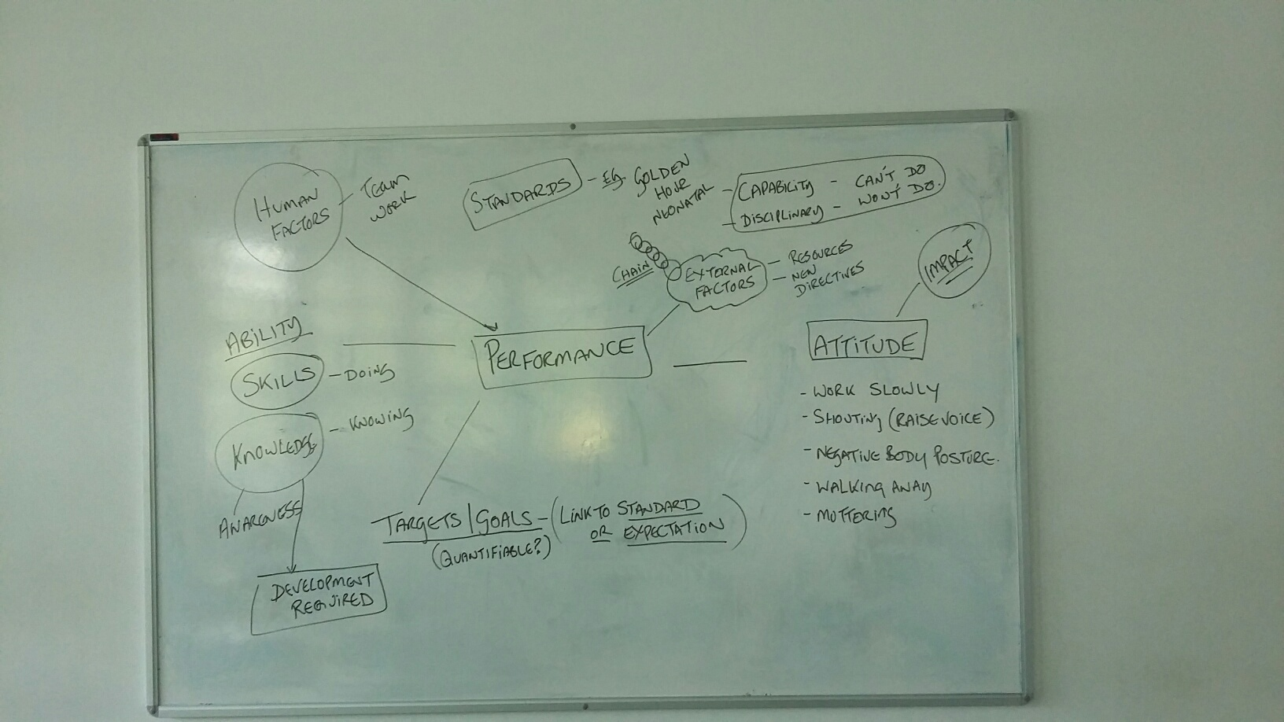
Discussion notes 11.07.16

Slide 5
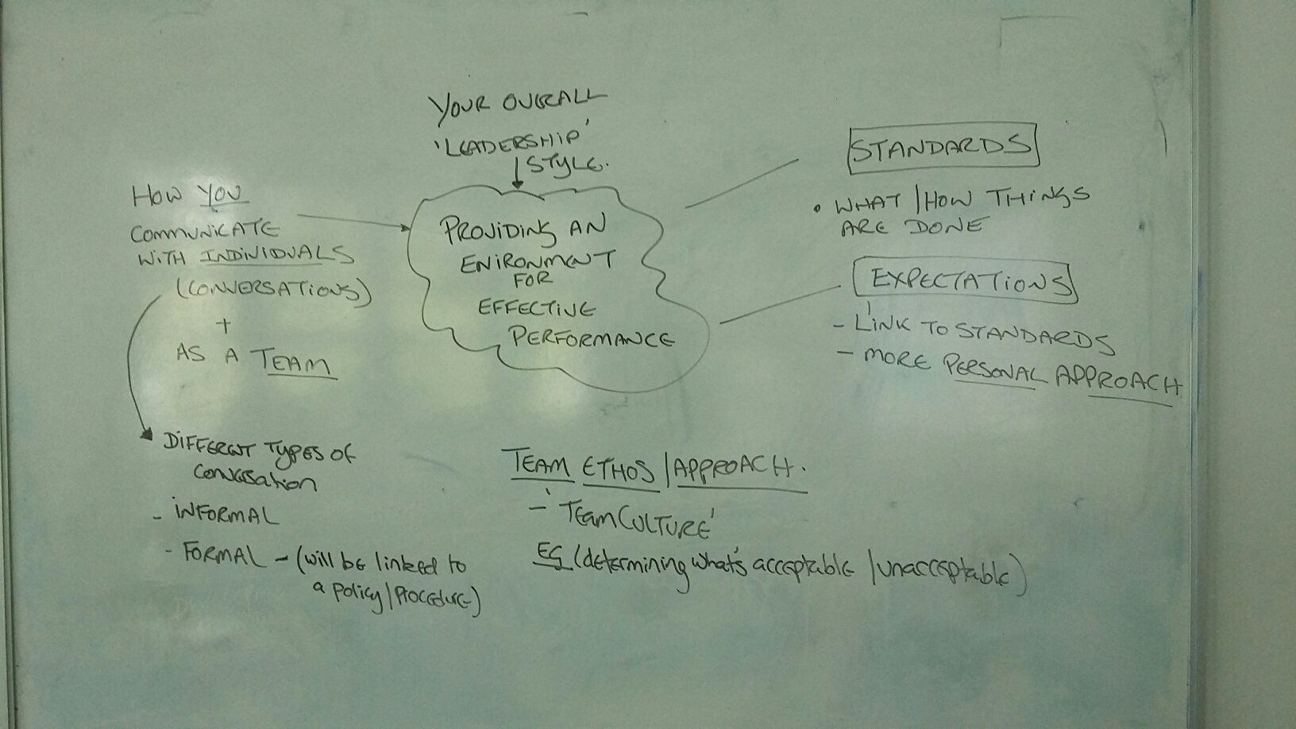
Discussion notes 11.07.16

Slide 6
Discussion
What are the main ‘performance issues’ in your workplace?
What are the main challenges for you – in your ‘managing performance’ conversations?

Slide 7
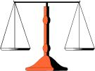
Managing individual and team performance
Employee responsibility
Organisational responsibility
what sits on either side?
Notes:
7

Slide 8
Managing Performance - overview
Overall purpose
RCHT objectives
Trust values
Department – purpose & plans
Line manager
Review – feedback, coaching
Your conversations with individuals
Informal / formal
PDR

Slide 9
Standards & expectations of performance
Standard of performance
Do you have clear expectations ….. and how do you make those clear to individuals and the team?
Notes:
9

Slide 10
3 main aspects to planning an individual’s performance
What do you expect the individual to be able to do / achieve?
How skilled / competent is the individual? How do they go about their role (attitude, demeanour)?
What development does the individual require?

Slide 11
Managing people / performance
Relationship with employee
Focus on performance measurement

Slide 12
Agreeing competencies / behaviours
Competencies are the behaviours that employees need to perform a job to a high level
They relate to how people deliver objectives rather than what the objectives are

Slide 13
How does an individual know how they are performing?
What sort of conversations are you having with individuals?
What is the impact / outcome of those conversations ?
When conversations go well …why do they go well?
Are you avoiding some conversations and if so why?

Slide 14
BOOST Model (feedback on performance)
Balanced – focus on the points for development & on strengths
Observed – base your feedback on what you have observed, rather than what you think about it
Objective – don’t refer to the personality but only to the actions and outcomes (behaviour)
Specific – back up your comments with specific examples of the observed behaviour
Timely – give your feedback as possible after the activity

Slide 15
Managing individuals who are not performing to the required standard

Slide 16
Performance – potential model (Tony Perryman 2007)
B – Workhorses Individuals who produce effectively, however they have reached their level of competency | A – Rising Stars Individuals who have real potential for the future and are high performers | High p e r f o r m a n c e Low
D – Deadwood Individuals who have no potential and perform poorly. They are in the wrong role! | C – Problem children Individuals who have potential but are not performing in their role. This may be because they are new to the role.
Low potential High

Slide 17
Capability – Can’t do
Concerned with performance
Disciplinary – Won’t do
Concerned with conduct

Slide 18
What might be the reasons for an individual’s lack of competence?

Slide 19
Employee & Organisation’s responsibility
Employee responsibility for satisfactory performance
Organisational responsibility to help & encourage

Slide 20
STANDARDS
Establish facts about
PERFORMANCE
P
E
R
F
O
R
M
A
N
C
E
1. ESTABLISH THE GAP
2. EXPLORE AND UNDERSTAND THE REASONS
+
3. ACT TO CLOSE THE GAP
(S)
a
-
training, coaching,
work experience,
counselling and
monitoring etc.

Slide 21
Informal stage – write to / email employee
Summarise the agreed improvement in performance required
Action & support needed to achieve this
Timescale
How performance will be monitored
Consequences ….if performance does not improve

Slide 22
Performance Development Action Plan
 | Objective | Success criteria | Target date | Comments
1
2
3
4
Any additional support required (e.g. OHD, counselling)?
Other points discussed:

Slide 23
In framing goals think of the following questions
Who? | Note person(s) who will be involved
What? | Specify clearly what you want to accomplish – the outcome
Where? | Identify the setting in which the work will occur
When? | Set time frame or time limit
Which? | Identify any requirements or restrictions
Why? | Describe the purpose / benefits of achieving goal
How? | What is strategy for meeting the goal? What data / evidence will you use to demonstrate success? Think of different ways in which the goal can be achieved

Slide 24
Formal stage
(indicates that required improvement not met)
Stage 1 (formal warning)
Meeting – individual & rep
- manager & HR (present case)
Possible outcomes
further time for improvement
written warning (on file for 12 months)
right of appeal
Action Plan - still in place as improvements need to be sustained
Stage 3 (dismissal)
same process as before
employee advised re dismissal
‘action short of dismissal’ – e.g. demotion, alternative employment may apply
Stage 2 (final warning)
same process as above
employee advised of next stage if no satisfactory improvement

