Slide 1



Managing Employee Conduct

Slide 2
Performance – Can or can’t do
(underpinned by the Capability policy)
Conduct – Will or Won’t do
(underpinned by the Disciplinary policy)

Slide 3
Underpinned by 3 Trust policies
Disciplinary policy and procedure
Dignity at Work
Grievances and Disputes policy

Slide 4
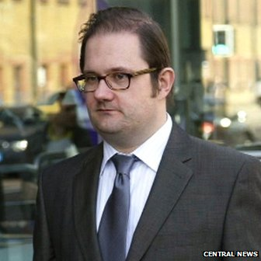
East Sussex NHS finance head jailed for £2.2m fraud
(2014)
A former head of financial accounting at two NHS trusts has been jailed for stealing £2.2m of NHS funds to buy 11 properties in Sussex and London.
Trevor Barry Cosson, from Hastings, worked for Hastings and Rother Primary Care Trust (PCT) and East Sussex Downs and Weald PCT when he took the money.
The 38-year-old was sentenced to five years and four months in prison at Blackfriars Crown Court.
The fraud investigation body discovered Cosson had manipulated the internal payments systems of the PCTs, setting up standing orders in the names of regular suppliers but paying money into his own bank accounts.
Trevor Barry Cosson used NHS funds to buy 11 properties

Slide 5

Employee & Organisation’s responsibility
Employee responsibility for satisfactory conduct & behaviour
Organisational & Departmental responsibility to state expectations & standards clearly

Slide 6
Standards of Conduct in the workplace
What standards of conduct do you have in your workplace?
How do staff know what is expected of them?
How do you monitor and maintain those standards?
What is your role & responsibility?

Slide 7
Bullying and Harassment
What do we mean by:
Bullying
Harassment
What is the difference?
Give some examples

Slide 8
The Equality Act - 9 Protected Characteristics
age
disability
gender reassignment
marriage and civil partnership
pregnancy and maternity
race
religion and belief
sex
sexual orientation
Under the Act people are not allowed to discriminate, harass or victimise another person because they have any of the protected characteristics.

Slide 9
BIFF Model
It is always difficult to tackle negative behaviour in a positive way that corrects the issue without causing resentment and / or damage to the relationship.
The BIFF model is one of the simplest and most effective ways of guiding your approach to the situation that I have come across.
Behaviour - what is it they are doing that is causing the problem? Present facts in order to reduce the risk of conflict. Be specific about the behaviour that you are seeing or experiencing from them.
For example; ”You have been more than 10 minutes late on three occasions this week”.
-
Feelings - express how this makes you feel i.e. Angry, sad, frustrated, etc. We can all relate to feelings more than their cause so they are a powerful way to give some ‘scale’ to the problem.
e.g. “This make me feel disappointed with you”.
Impact -What impact is their behaviour having? Again, present facts to reduce the risk of conflict and again be specific about how their behaviour is impacting you, the team, the organisation or your customers.
e.g. “Whenever you are late someone else has to cover your position and this means they are diverted from getting on with their own work”.
Future - open the discussion on what changes are to be made. This is the start of 2-way discussion. Stick to the facts laid out in the BIFF steps to prevent denial or reasoning of the situation.

Slide 10
Engaging
Situation: | What do I really want? | What do I really not want?
For myself
For this person
For others impacted
For this relationship
What will I say and how would I behave if I wanted the results above?

Slide 11
Pull
Push
pull
push
Open
questions
Active
Listening
Stating
Views
Making
suggestions
2 main communication approaches

