Slide 1
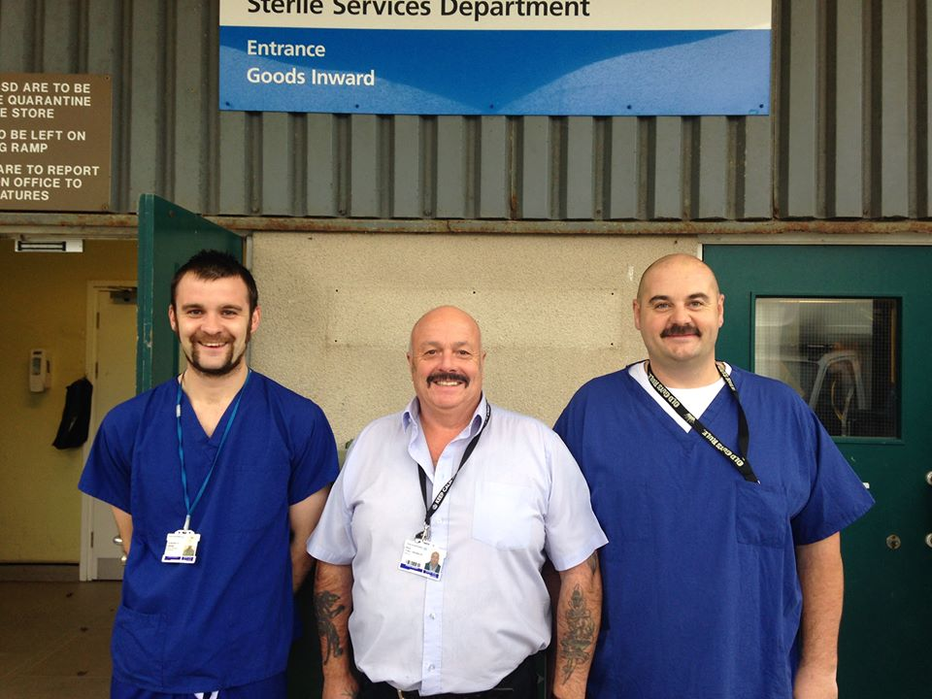
A JOURNEY THROUGH SSD
A JOURNEY THROUGH SSD WORKING LIFE

Slide 2
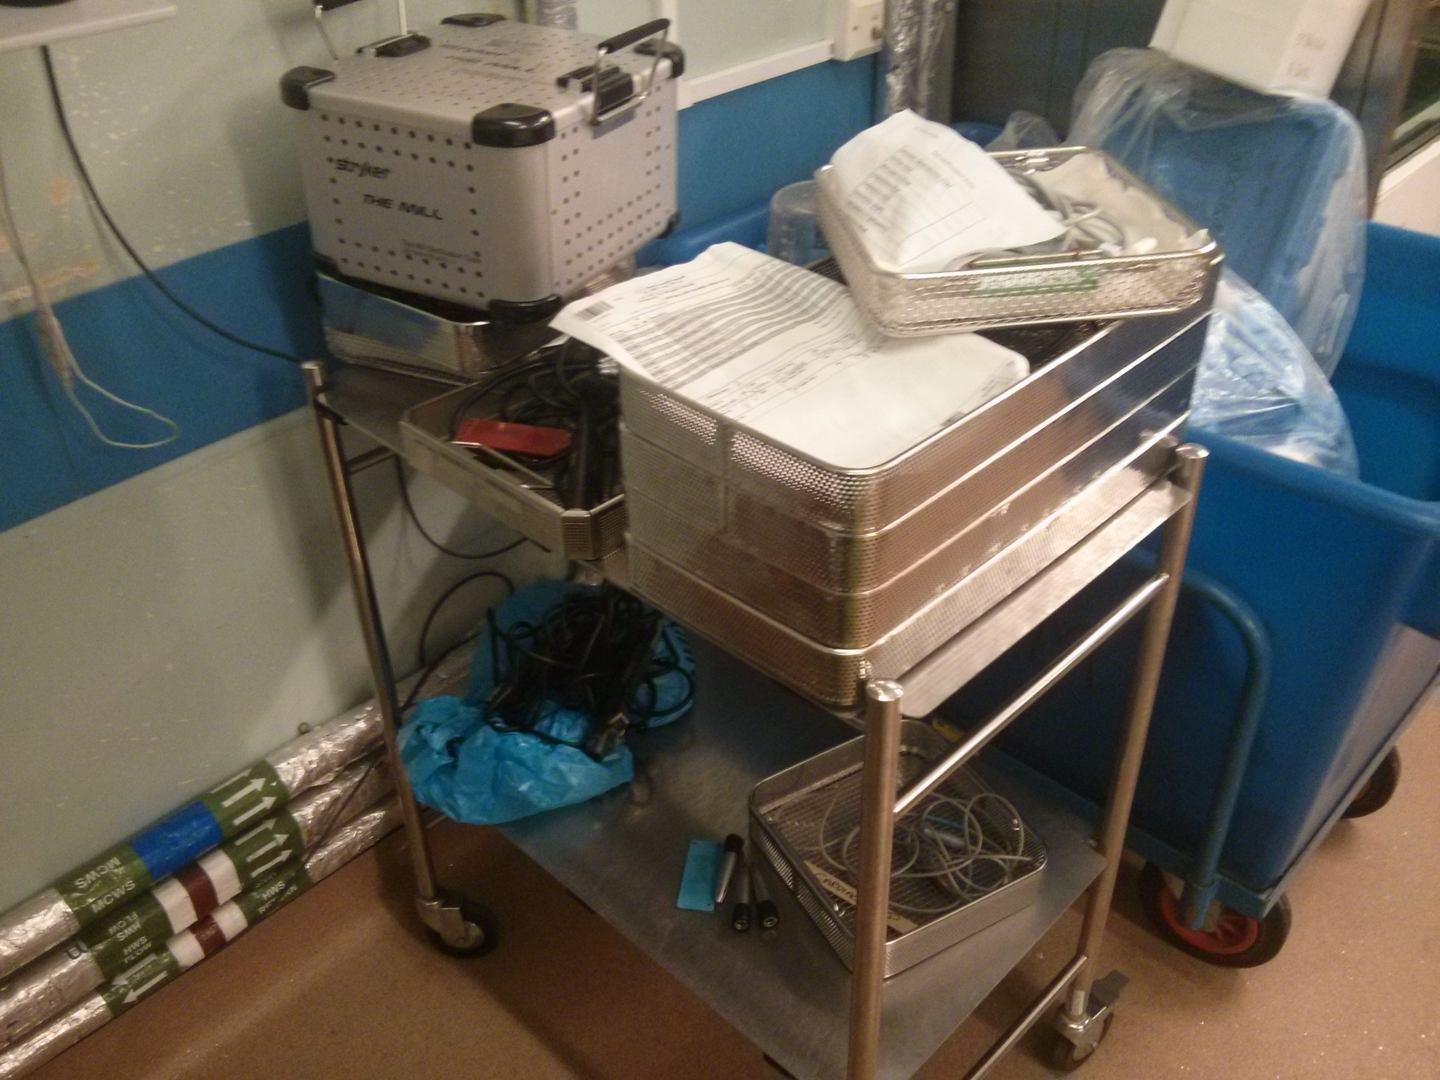
THE ‘HANDWASH’

Slide 3
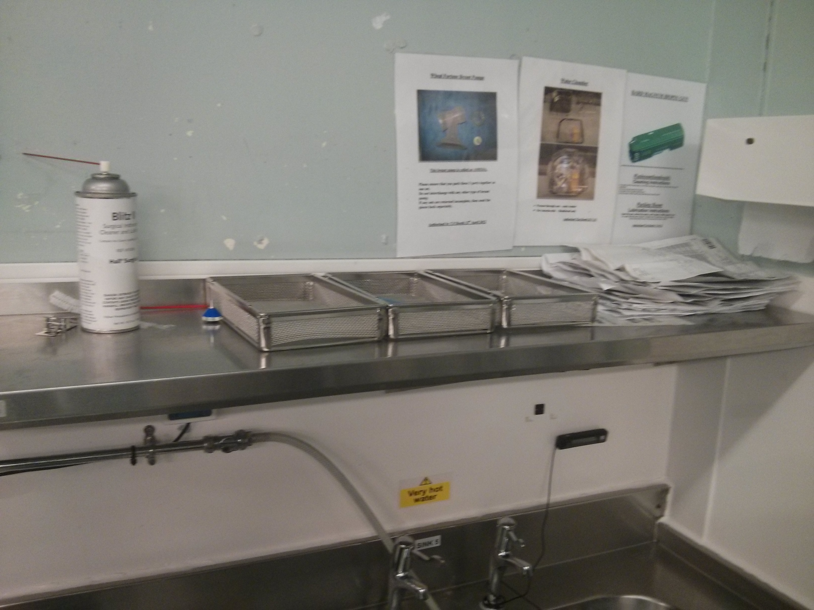

Slide 4
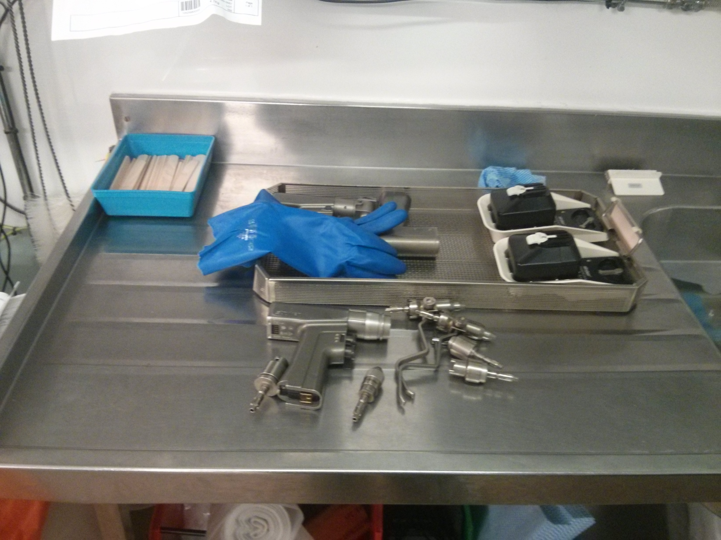

Slide 5
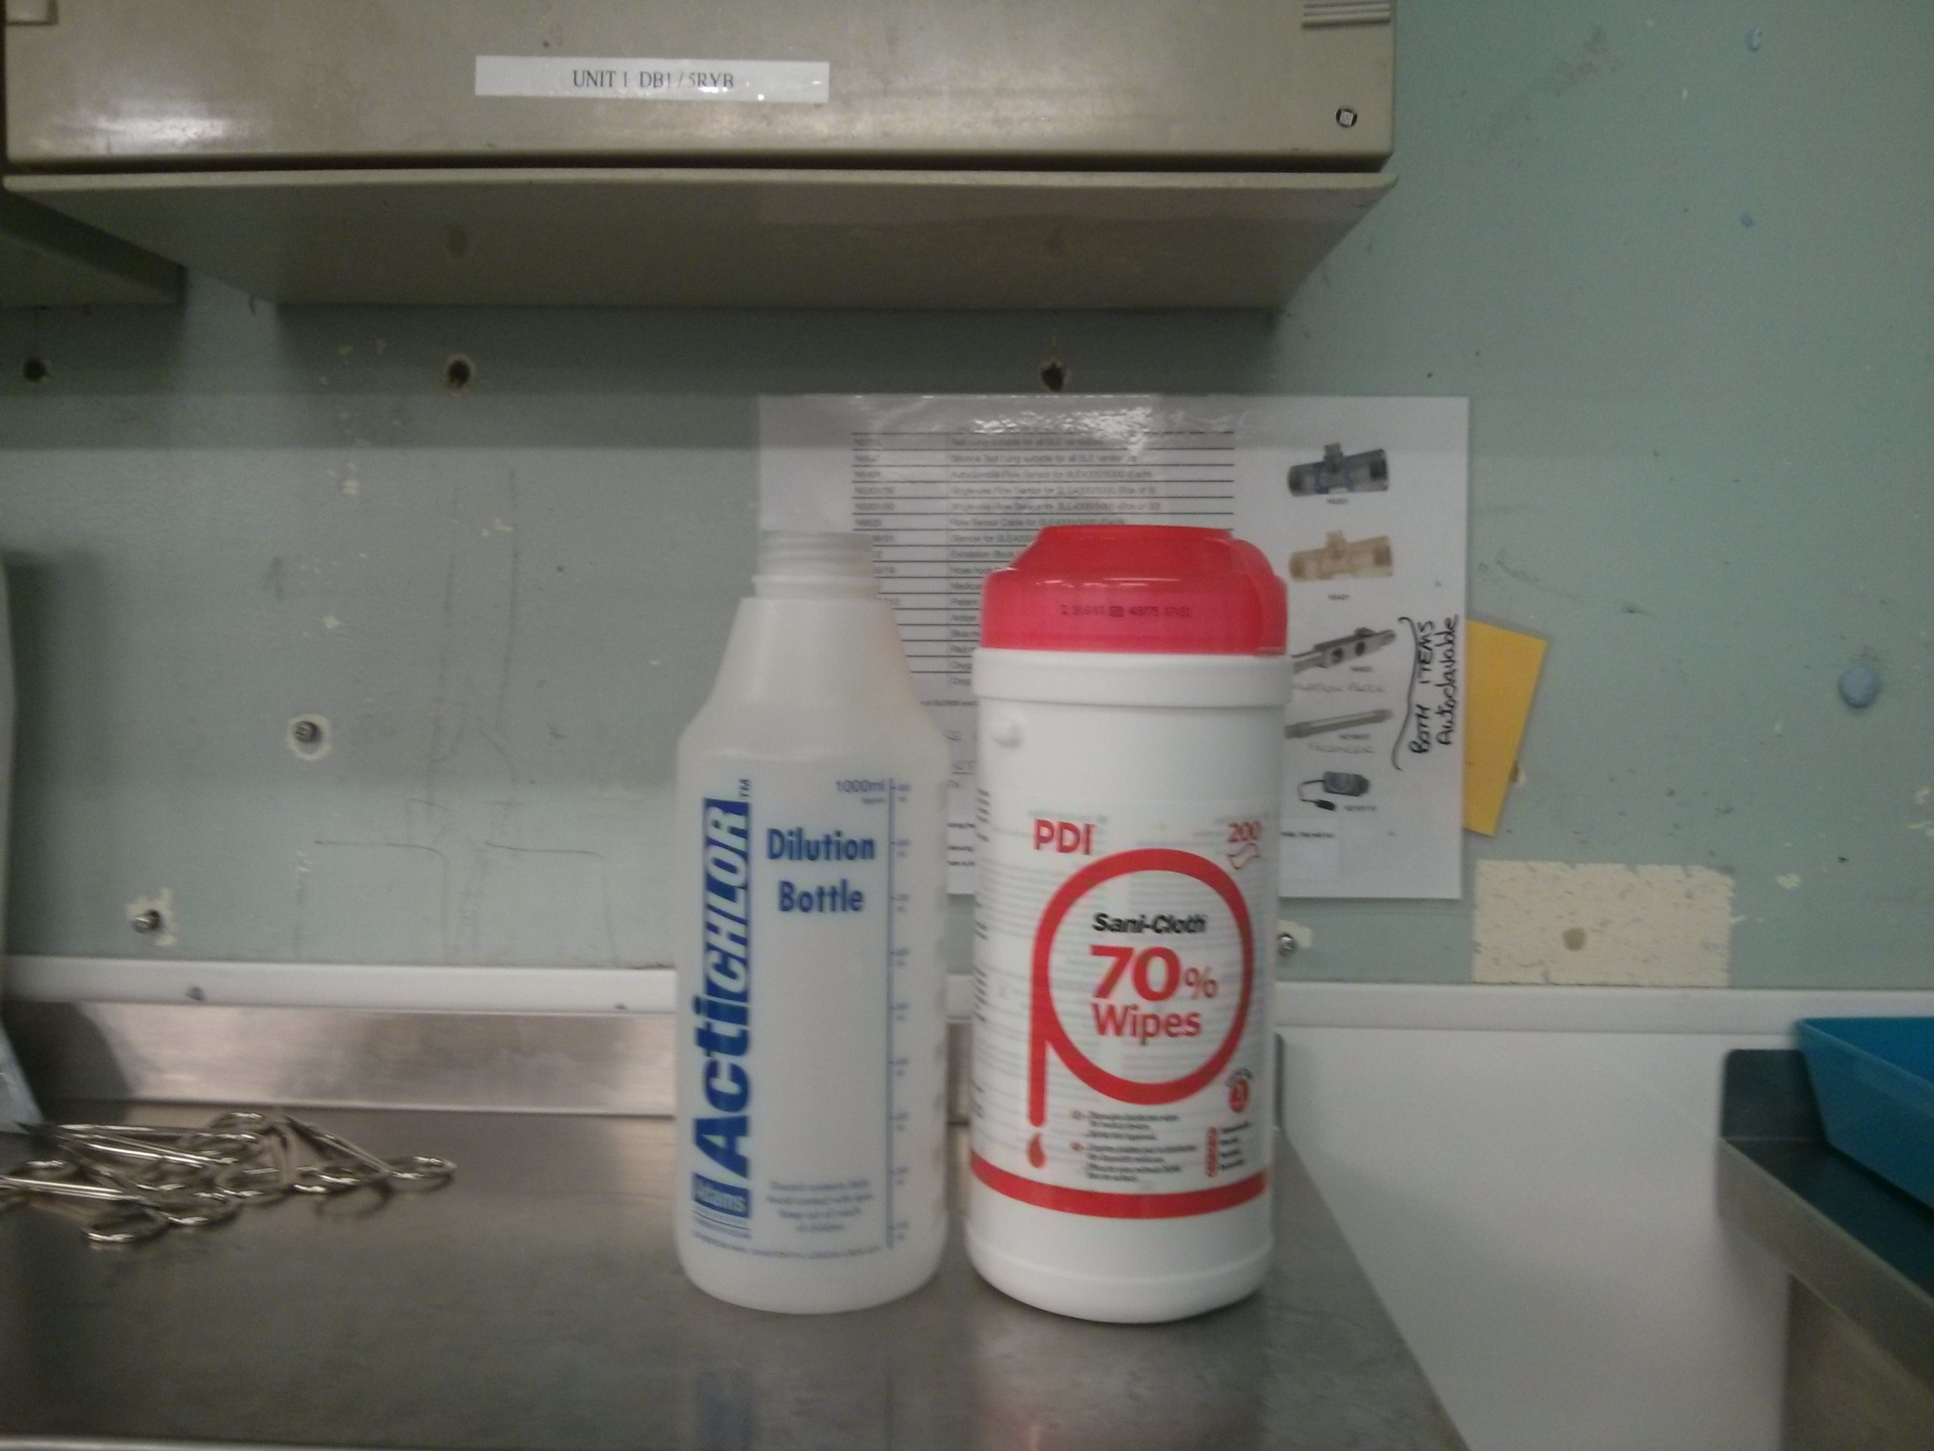

Slide 6
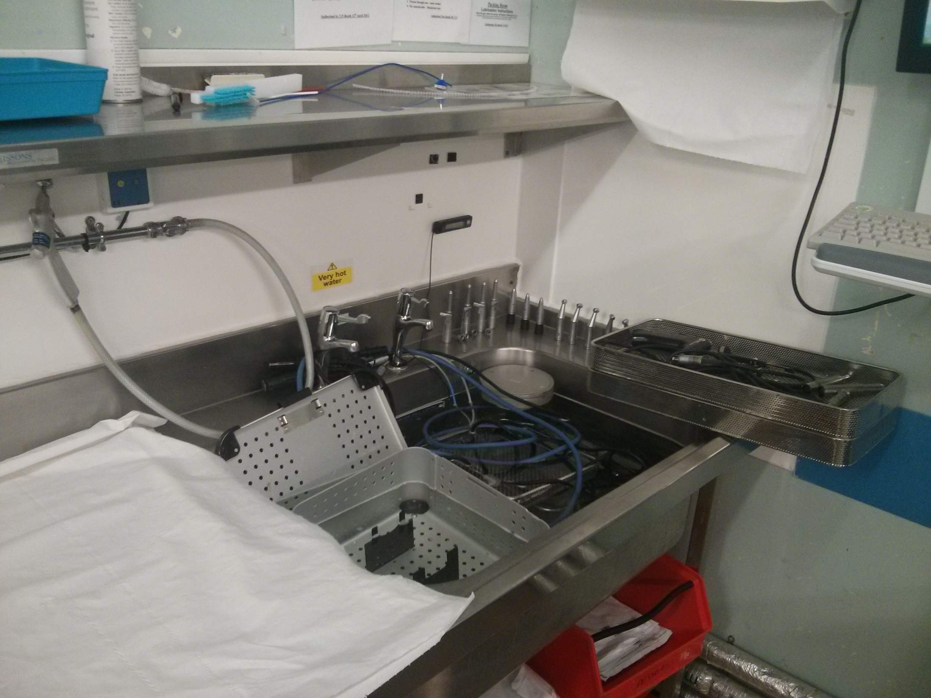

Slide 7
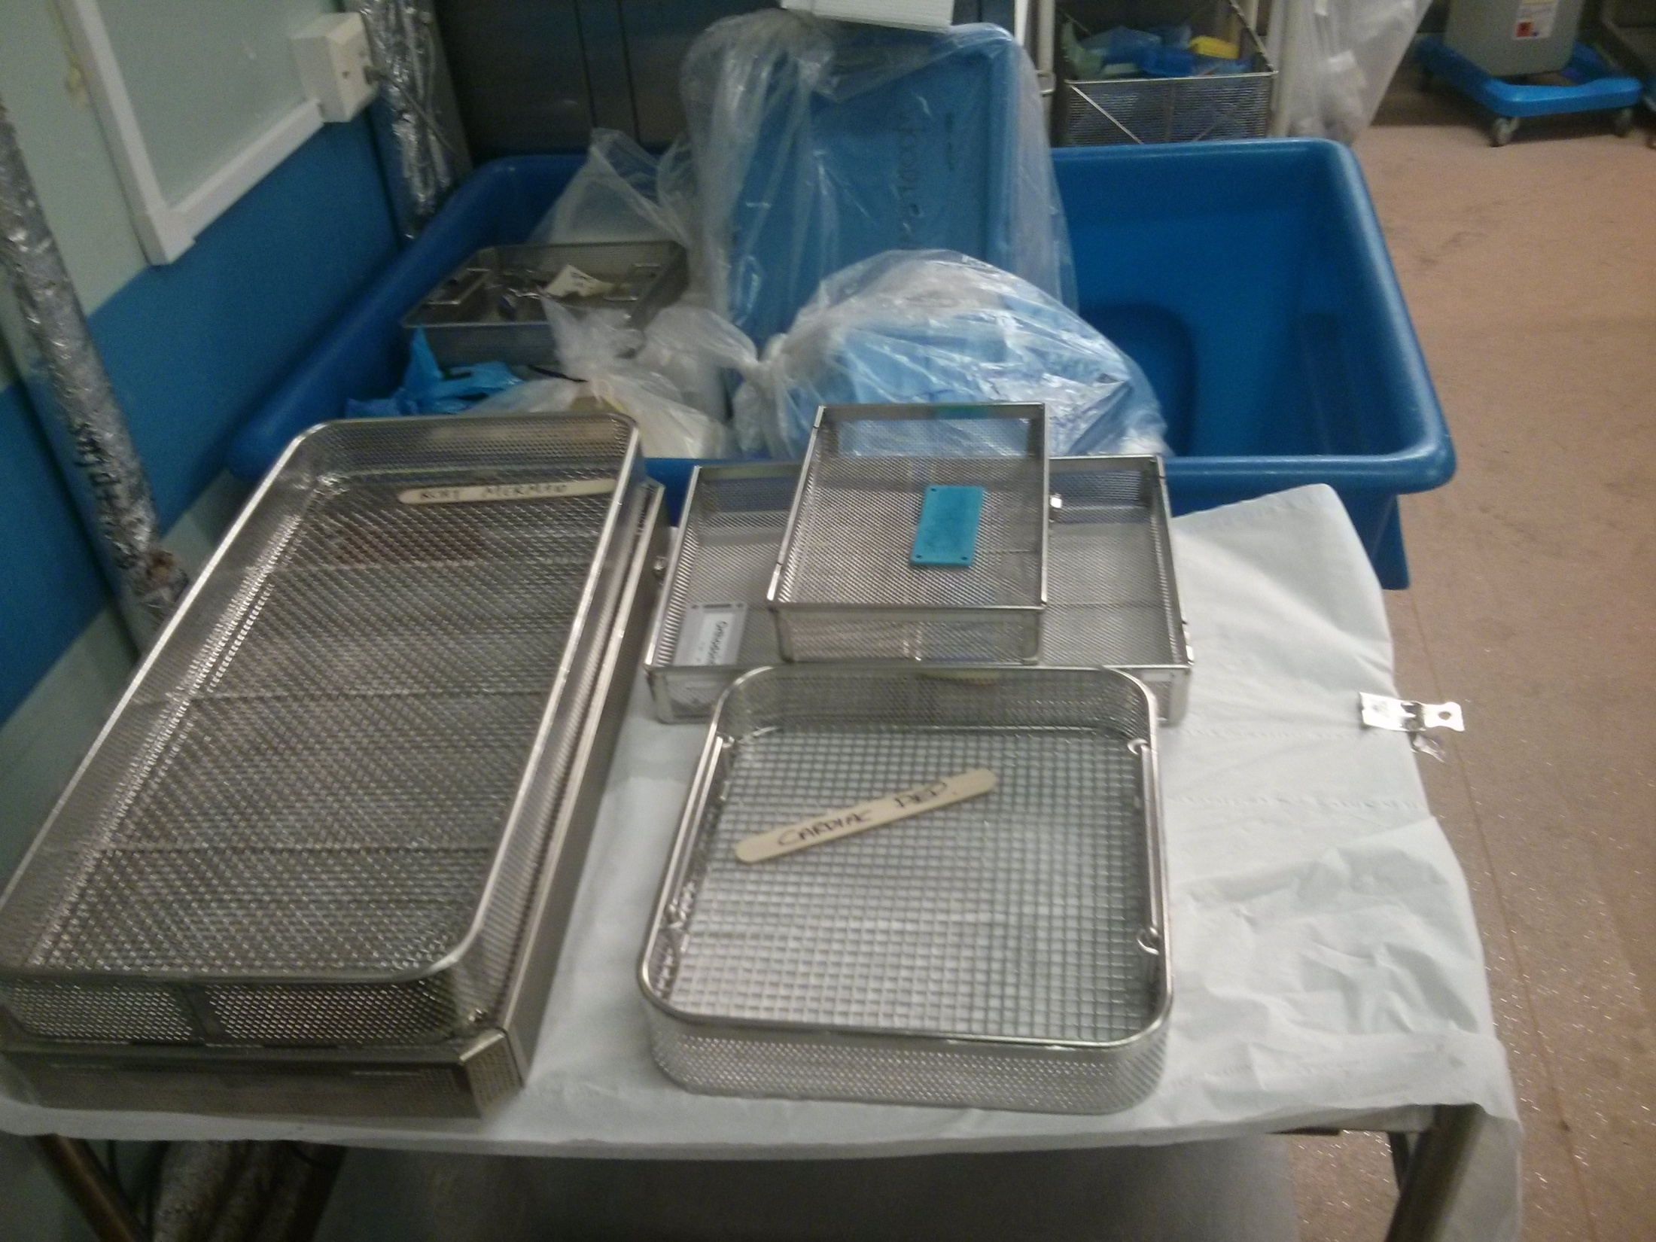

Slide 8
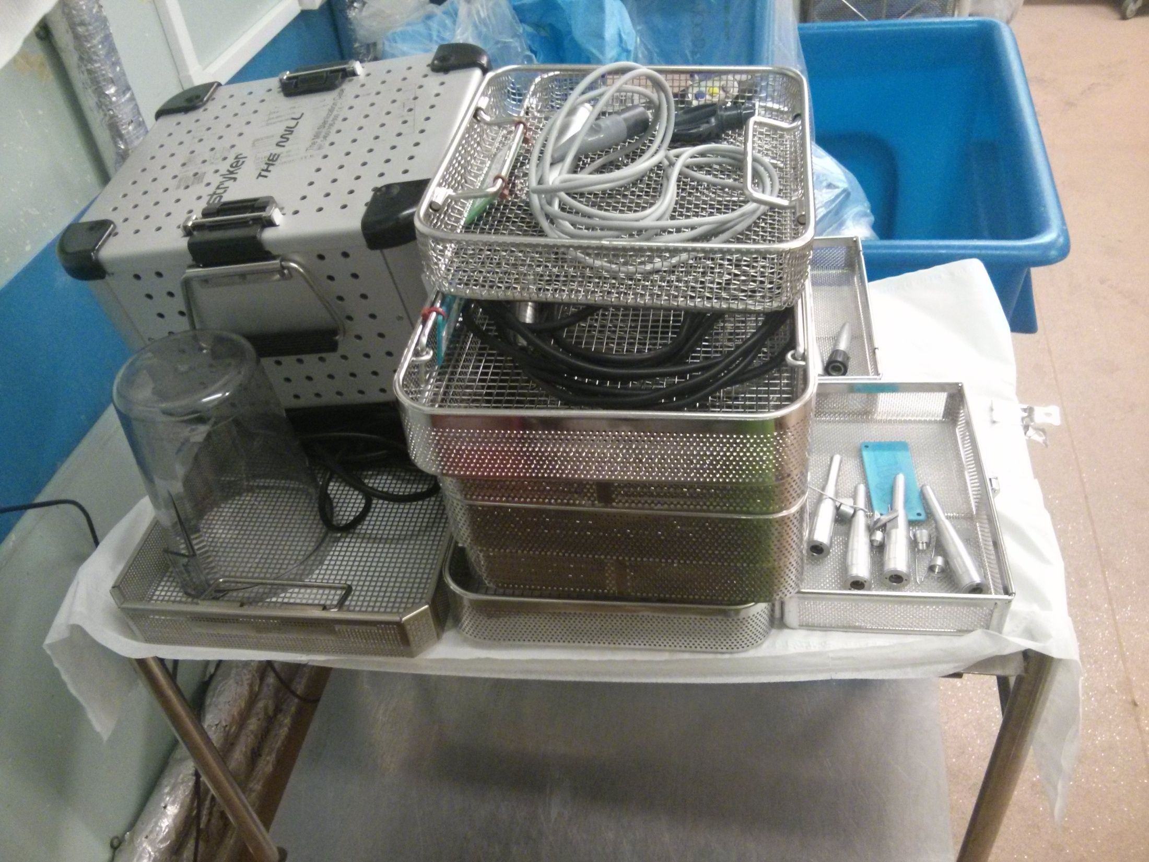

Slide 9
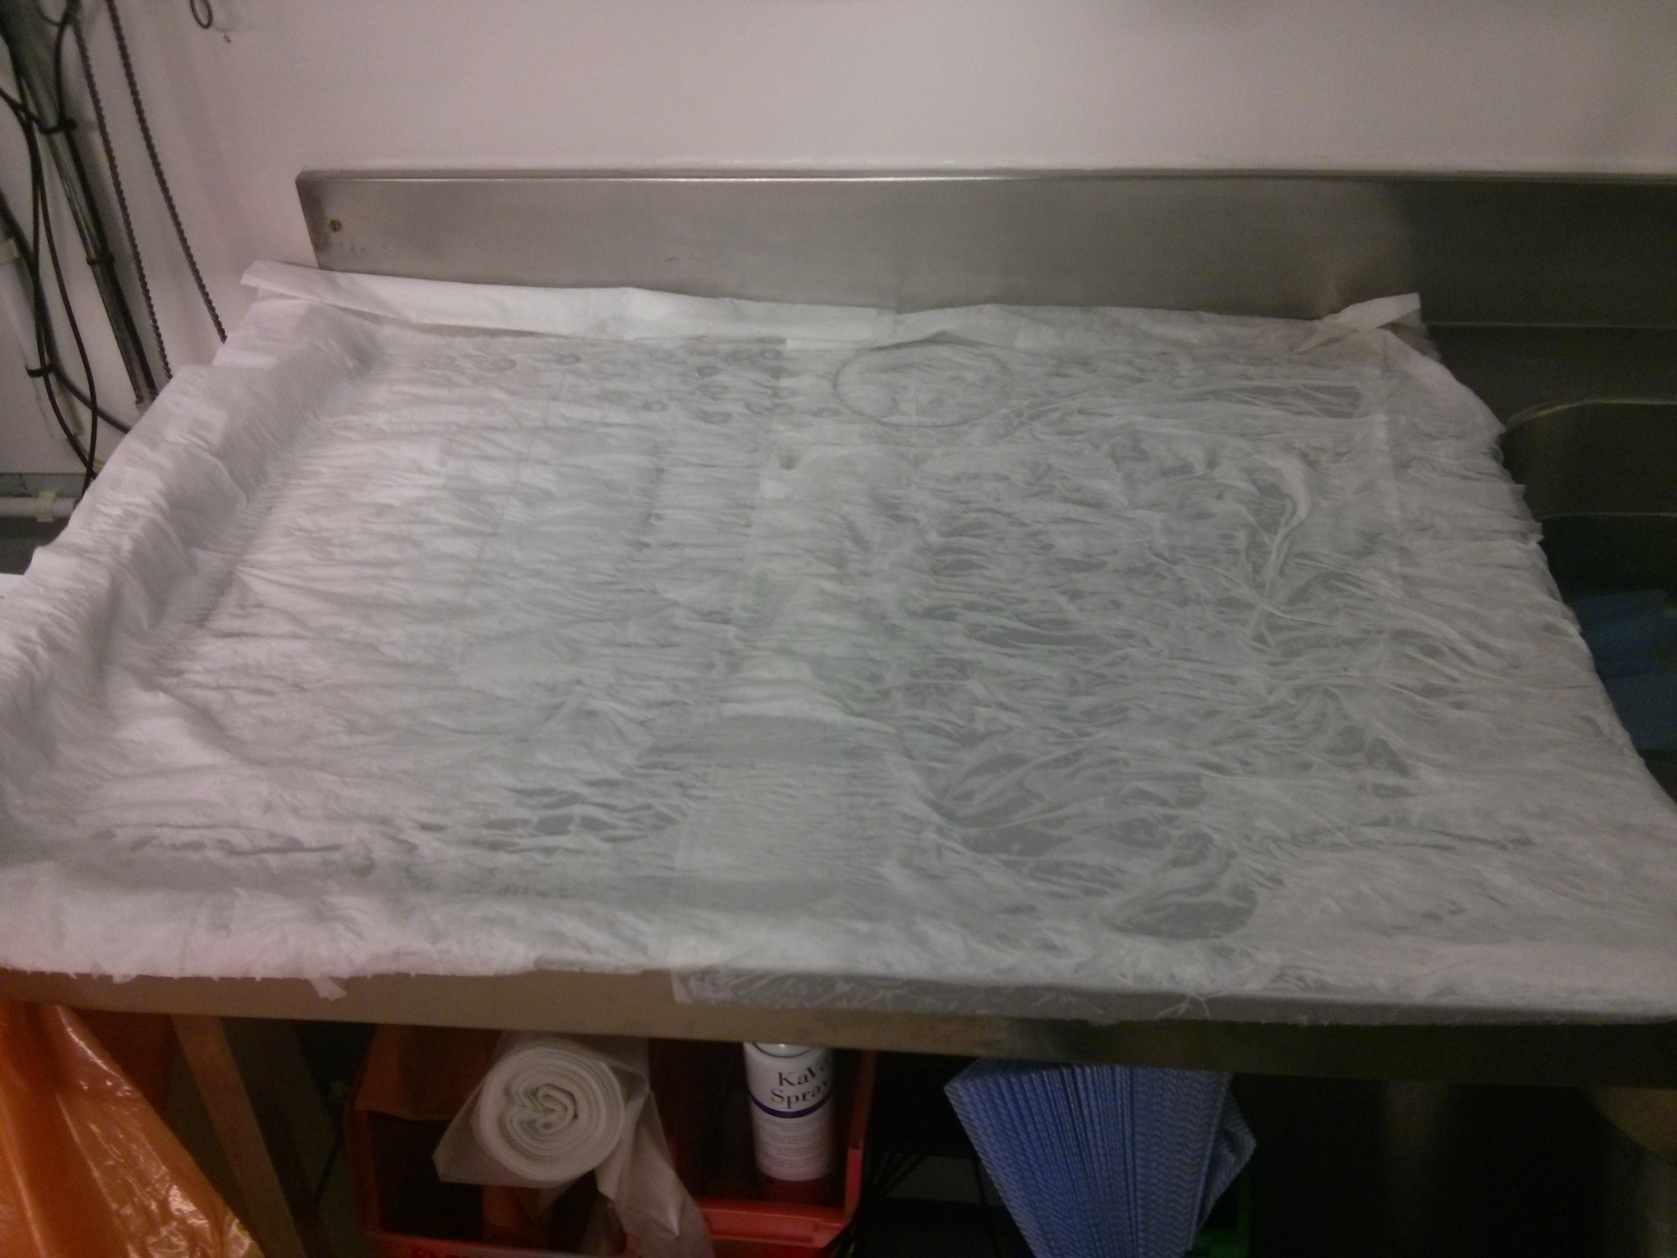

Slide 10
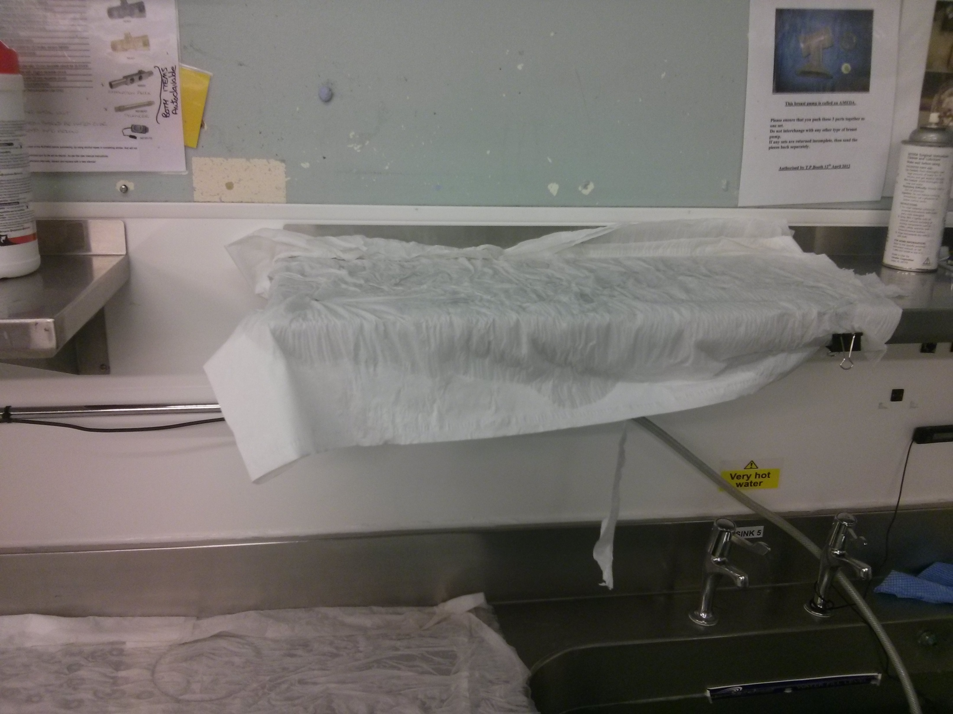

Slide 11
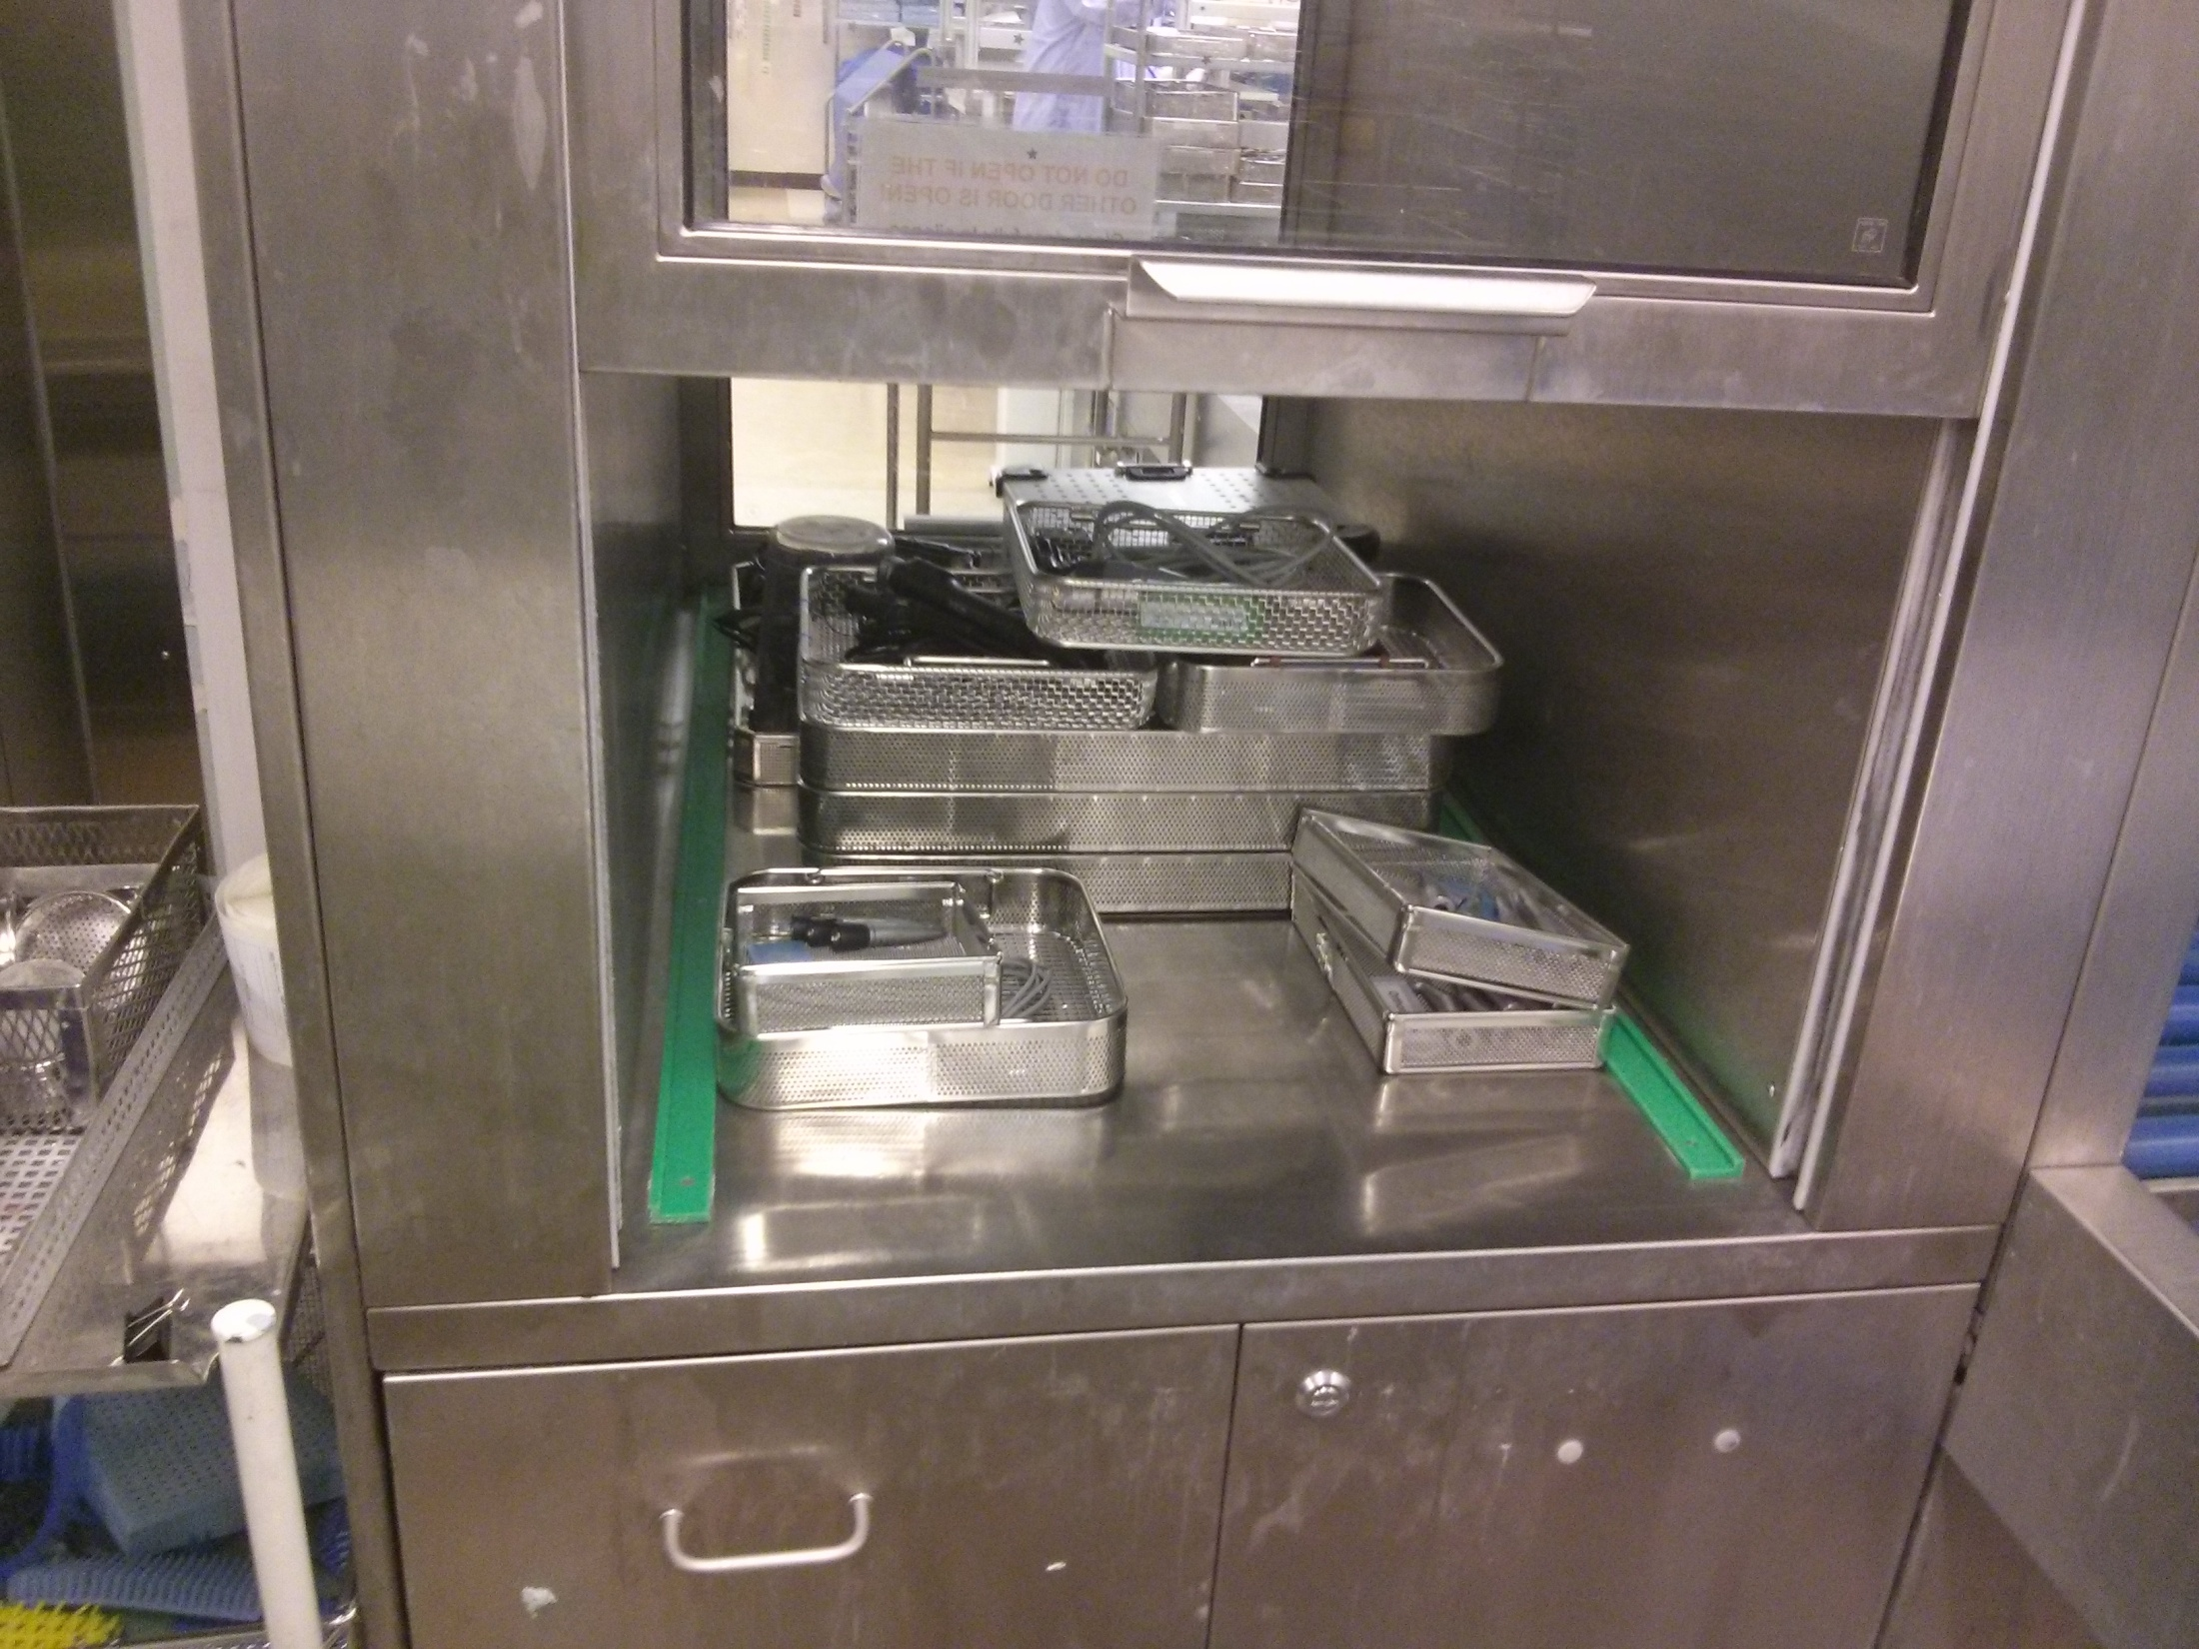
DANIEL GOLEMAN (1998): MOTIVATION AND SELF-REGULATION

Slide 12
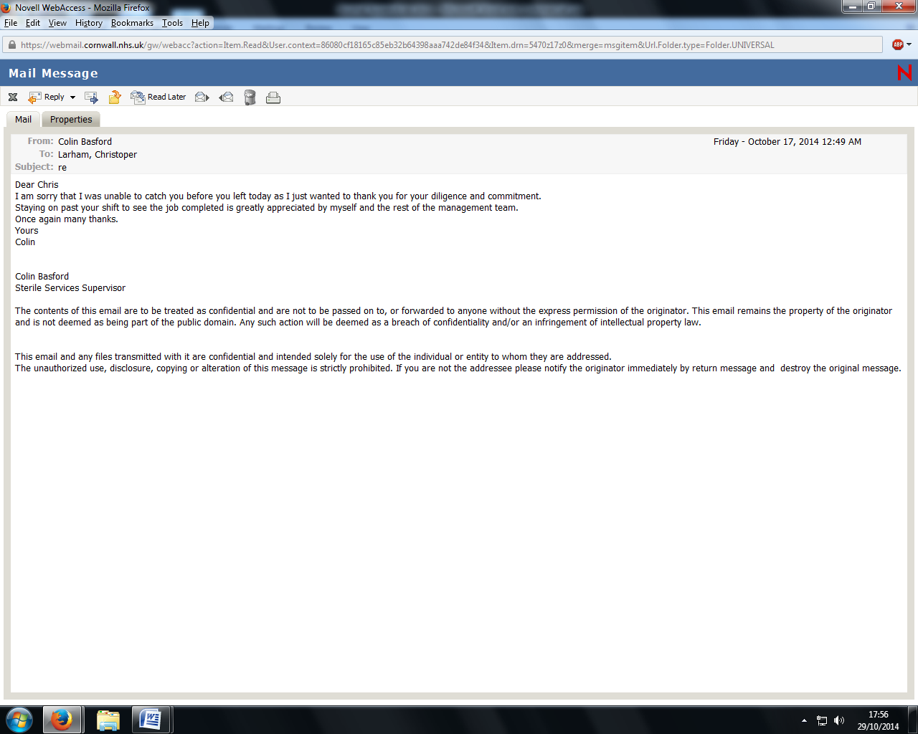

Slide 13
WASH METHOD OF ITEM | EFFECT OF SCANNING THIS ITEM INTO THE 'MANUAL WASH' (HANDWASH) MODULE | CONSEQUENCES
"HANDWASH ONLY“ "MACHINE WASH ONLY“ "MACHINE WASH" | No error message Error message - "This item cannot be manually washed." No error message | Able to be processed correctly in the Packing Room Must be scanned onto a washer carriage in the Wash Room, then processed as usual in the Packing Room Error message in the Packing Room - "In Wash Area - Manually Washed." Confusion amongst staff members in the Packing Room, leading to clean items being sent back to the Wash Room labelled "FAO Darren/Angela". Once passed back, these items have to be re-washed.

Slide 14
TIME COSTS | TIME BENEFITS
Time taken to access administrative module of the tracking system (1 minute) Checking- and correcting where necessary- the specified 'Wash Method' of each item (1 minute per item) Time taken to re-access Washer module to process items in the Wash Room (1 minute) | Time saved in avoiding confusing error message in the Packing Room, a note "FAO Darren/Angela" being written, and item passed to the Wash Room (1 minute) Time saved through avoiding having to wait for Darren/Angela to be alerted to the troublesome items the following day (approximately 12 hours, since the items would be returned at 10:30pm and brought to Darren/Angela's attention at around 10:30am) Time saved thanks to lack of re-processing (5 minutes per item)

Slide 15
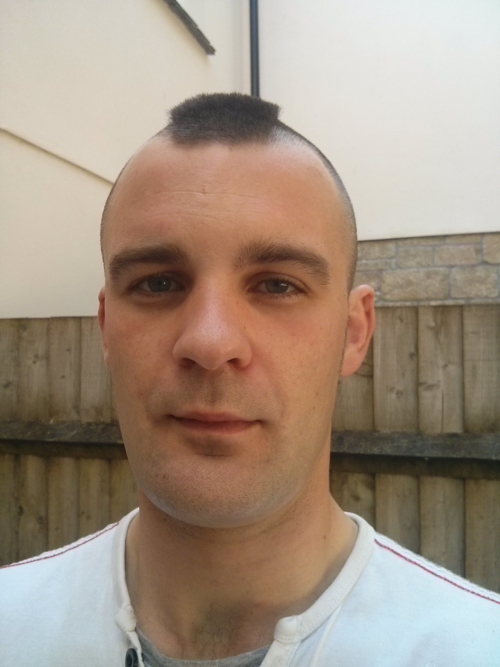
SELF-AWARENESS; THE REFLECTIVE
PRACTITIONER
INSIGHTS PROFILE:
STRENGTHS
I am driven to complete tasks in an accurate and careful way, leading to workplace strengths and values in the form of: trustworthiness; an ability to solve problems; working late to finish the job; being realistic, systematic, and adaptable in my working behaviour; and having high competence in processing technical data.
WEAKNESSES
Potential weaknesses include occasional failings to consider the feelings of others, and a tendency to over-rely on analysis to the detriment of concrete action. An area for improvement caught my attention: I should share my ideas with other people, rather than keeping them to myself.

Slide 16
EMPATHY
PROSCI’S ADKAR MODEL:
AWARENESS, DESIRE, KNOWLEDGE, ABILITY, REINFORCEMENT
SOCIAL SKILL
Leader-Image Compatibility
Steps in leading successful transformation

Slide 17
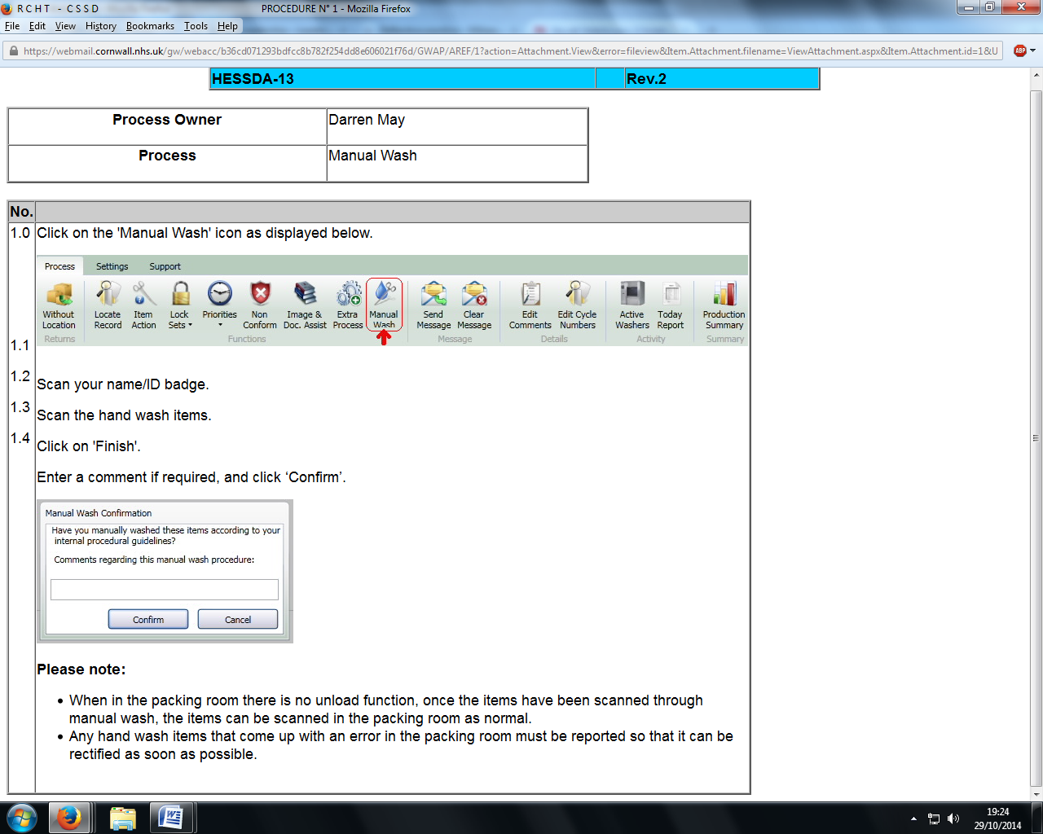

Slide 18
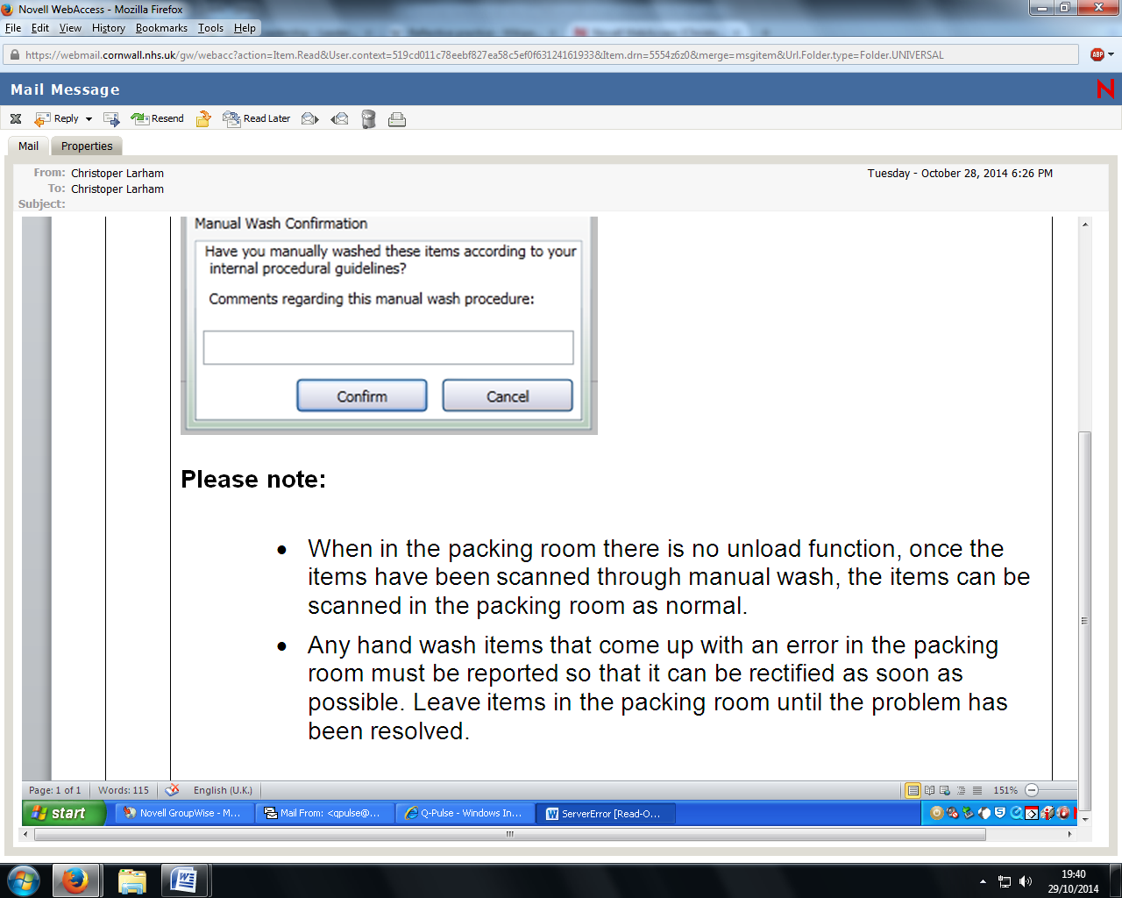

Slide 19
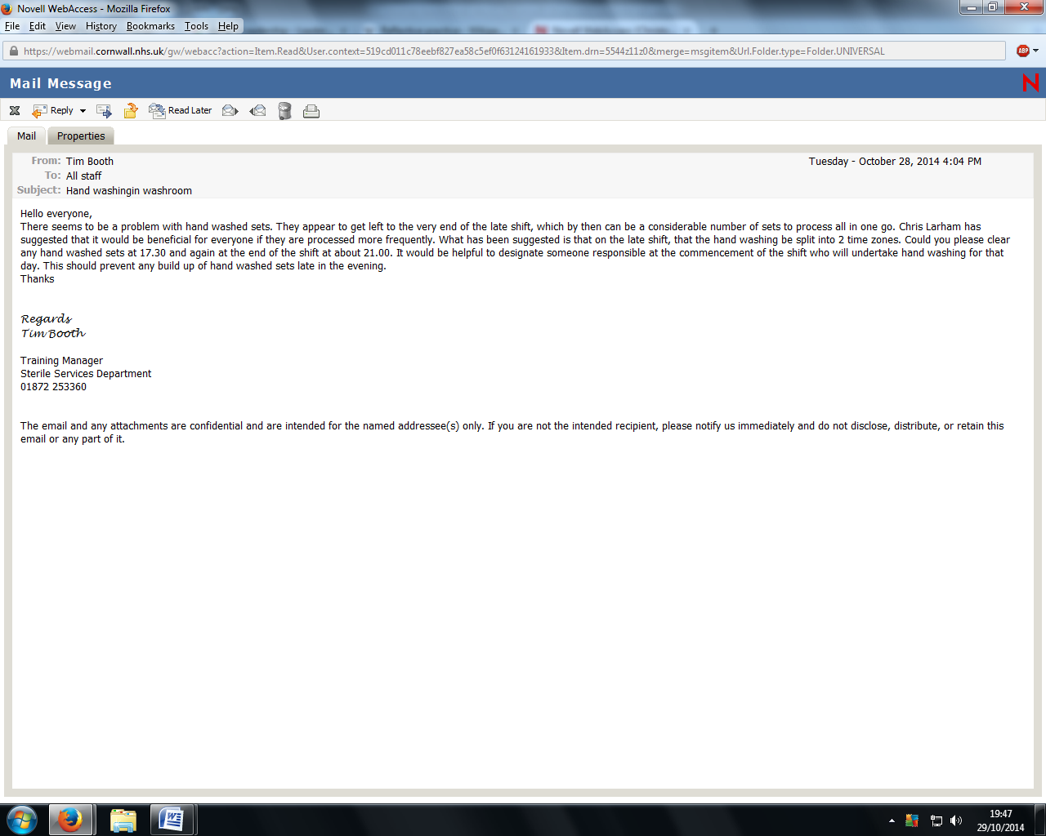
CONCLUSION

Slide 20
REFERENCES
Collins, J. (2001) Level 5 Leadership: The Triumph of Humility and Fierce Resolve, Harvard Business Review, 79; 1, 66-76
Dunegan, K. (2003) Leader-Image Compatibility: An Image Theory View of Leadership, Journal of Business and Management, 9; 1, 61-72
Goleman, D. (1998) What Makes a Leader? Harvard Business Review, 76; 6, 93-102
Herzberg, F. (1968) One more time: how do you motivate employees? Harvard Business Review, 46; 1, 53-62
Hiatt, J. (2006) Adkar: A Model for Change in Business, Government and Our Community, Colorado: Prosci Learning Center Publications
Hill, R., and the MindTools Team. (undated) Deciding, Quantitatively, Whether to go Ahead. [Online] Available at: http://www.mindtools.com/pages/article/newTED­_08.htm. [Accessed 29 October 2014]
Kotter, J. (1995) Leading Change: Why Transformation Efforts Fail, Harvard Business Review, 73; 2, 59-67
The Insights Group Limited. (2014) Insights Discovery Personal Profile: Christopher Larham (Foundation Chapter)
Schön, D. (1983) The Reflective Practitioner: How Professionals Think in Action, New York: Basic Books

